Slide 1
CHAPTER 1
FUNCTIONS AND MODELS

Slide 2
CONTENTS
1.1 Four way to represent a function
1.2 Model and Curve Fitting
1.3 New Functions from Old Functions
1.4 Graphing Calculators and Computers
1.5 Exponential Functions
1.6 Inverse Functions and Logarithms
1.7 Parametric Curves

Slide 3
1.7 PARAMETRIC CURVES
1.7.1 Parametric Curves
1.7.2 Graphing Devices
1.7.3 The Cycloids
1.7.4 Family of Parametric Curves

Slide 4
1.7.1 Parametric Curves
y
C
M(x,y)=(f(t),g(t))
0
x
It is impossible to describe the curve C by an equation of the form y=f(x). However to describe the motion of a point M(x,y) on C we can use two functions of time
x = f(t) y = g(t)
called parametric equations. C is a parametric curve

Slide 5
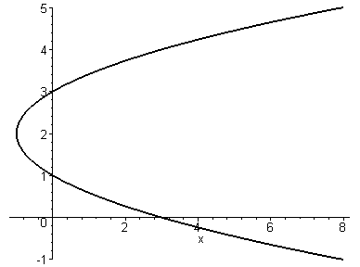
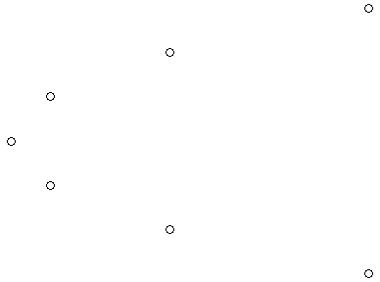
Example: sketch and find the curve defined by:
x = t² - 2t y = t + 1
t | x | y
-2 | 8 | -1
-1 | 3 | 0
0 | 0 | 1
1 | -1 | 2
2 | 0 | 3
3 | 3 | 4
4 | 8 | 5
t=3
t=4
t=2
t=1
t=0
t=-1
t=-2
The particle with coordinates (x(t),y(t)) moves when the time t changes. It slows down before reaching the point (-1,2) then it speeds up.

Slide 6
It seems that the particle traces a parabola.
To verify that, we eliminate t from the equations
x = t² - 2t y = t + 1
We have indeed from the 2nd equation: t = y – 1.
Substituting this into the first equation:
x = t² - 2t = (y –1)² – 2(y –1) = y² – 4y + 3
This is the equation of a parabola with horizontal axis.

Slide 7
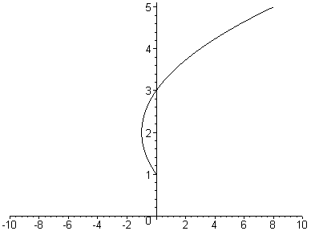
Note. If there is some restriction on the parameter, e.g. 0 ≤ t ≤ 4 then we only obtain part of the parabola which starts with (0,1) and ends with(8,5)
In general the curve with parametric equations:
x = f(t), y = g(t), a ≤ t ≤ b
has initial point (f(a), g(a)) and
terminal point (f(b), g(b))

Slide 8
Example: find the curve defined by:
x = cost, y = sint 0 ≤ t ≤ 2π
As before, if we plot various points on that curve, we found that they all lie on a circle. The equation of the circle is obtained by eliminating t:
x² + y² = cos²t + sin²t = 1
t=π/2
(cost,sint)
t=π
t
t=0
t=2π
t=3π/2

Slide 9
Example: find the curve defined by:
x = sin2t, y = cos2t 0 ≤ t ≤ 2π
The equation of the curve is obtained by eliminating t:
x² + y² = sin²2t + cos²2t = 1
This is also the unit circle traced twice clockwise
t=0,π,2π

Slide 10
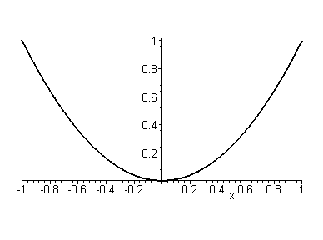
Example: sketch the curve defined by:
x = sin t, y = sin² t
The equation of the curve is obtained by eliminating t:
y = sin² t = x²
This is part of the parabola y = x², -1 ≤ x ≤ 1

Slide 11
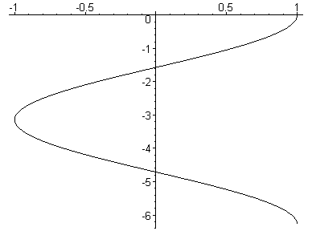
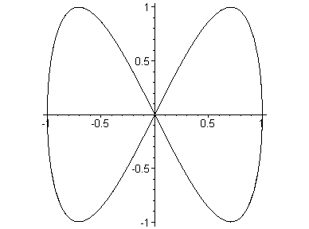
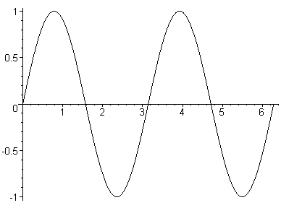
The moving point on the curve: x = cost, y = sin2t
is synchronized with the points on the graphs of f(t) = cost and g(t) = sin2t
f(t)=cost
g(t)=sin2t
(cost,sin2t)

Slide 12
1.7.2. GRAPHING DEVICES
With MAPLE we can draw parametric curves as simple as when we sketched the graphs of functions
Recall that to sketch the graph of a function y=f(x), a ≤ x ≤ b , we use the MAPLE command:
> plot(f(x), x=a..b );
With a parametric curve x=f(t),y=g(t), a ≤ t ≤ b we use
> plot([f(t), g(t), t=a..b]);

Slide 13
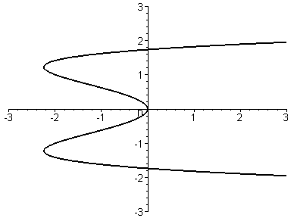
Example: graph the curve x = y⁴ – 3y²
Solution. We can use MAPLE to plot the parametric curve
x = t⁴ - 3t², y = t

Slide 14
In general, to graph the curve x = g(y), we can use the plot command for the parametric equations: x=g(t), y=t
Of course the curve y = f(x), may also be plotted as the parametric curve: x=t, y=f(t)
As a consequence, the graph of the inverse function f ^{–1} of the function f may be obtained by graphing the parametric curve x=f(t), y=t because it is clearly the reflection of the curve x=t, y=f(t) about the line y=x

Slide 15
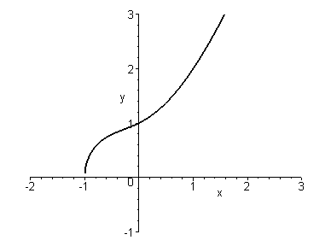
Example: show that the function is one-to-one and graph both f, f ⁻¹
Solution. Plotting the curve y=f(x) and using the Horizontal Line Test we see that f is one-to one

Slide 16
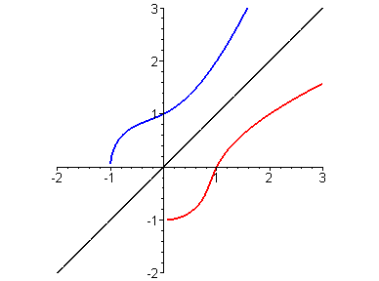
We can plot both graphs of f and f ^{–1} and the line y=x using the following MAPLE command
> f:=sqrt(t^3+t^2+t+1);
> plot([[f,t,t=-2..3],[t,f,t=-2..3],[t,t,t=-2..3]]);

Slide 17
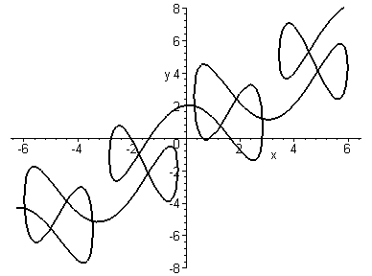
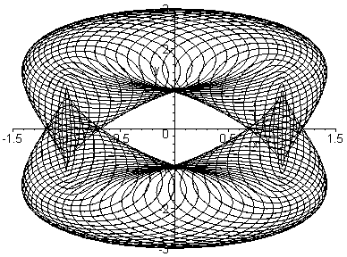
Using Computer Algebra Package, we can graph very complicated curves
x=t+2sin2t, y=t+2cos5t
x = cost – cos80t sint, y = 2sint – sin80t

Slide 18
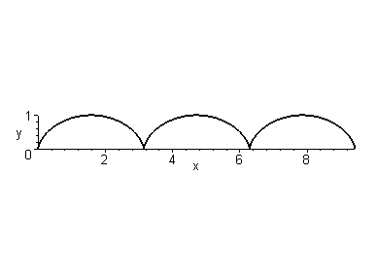
1.7.3. The Cycloid
P
P
P
The cycloid is traced out by a point P on a circle C as C rolls along a straight line

Slide 20
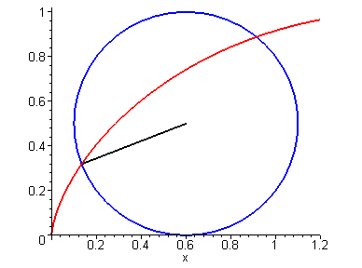
⎪OT⎪ = arc PT = rθ ⇒ center of circle is C(rθ, r). The coordinate (x, y) of P is given by
x =⎪OT⎪- ⎪PQ⎪ = rθ – rsinθ = r(θ – sinθ) y =⎪TC⎪- ⎪QC⎪ = r – rcosθ = r(1 – cosθ)
C(rθ,r)
θ
P
Q
O
T
Parametric equations:
x = r(θ – sinθ), y = r(1 – cosθ)

Slide 21
1.7.4. Family of Parametric Curves
Example: investigate the family of parametric curves:
x = a + cos t y = a tan t + sin t
What do they have in common?
How does the shape change as a increase?
Solution: we use MAPLE to sketch the curve for a = -2, -1, -0.5, -0.2, 0, 0.5, 1, 2.

Slide 22
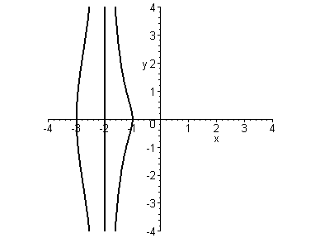
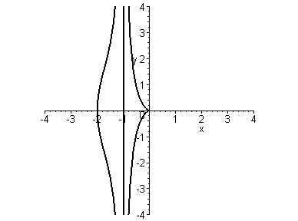
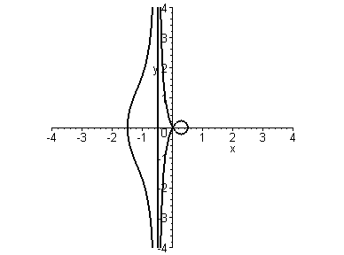
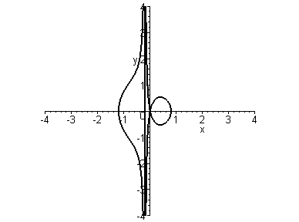
a=–2
a=–1
a=–0.5
a=–0.2
All of these curves (except when a=0) have two branches. Both branches have the common asymptote x=a

Slide 23
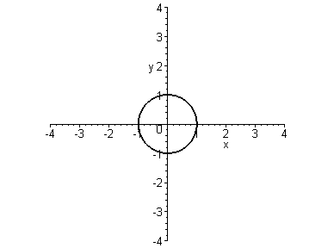
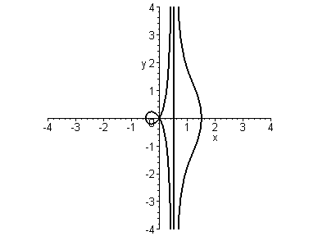
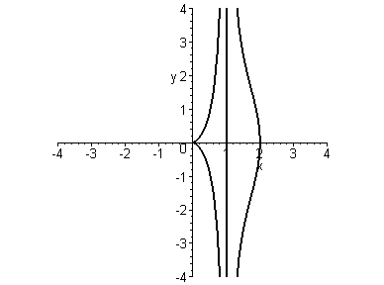
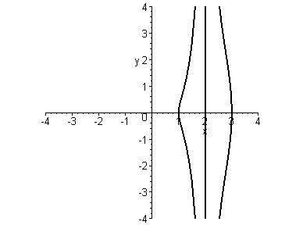
a=0
a=0.5
a=1
a=2
All of these curves (except when a=0) have two branches. Both branches have the common asymptote x=a

Slide 24
a=-2
a=-1
When a < -1 both branches are smooth
When a reaches –1 the right branch has a cusp
For –1 < a < 0 the cusp becomes a loop which grows larger and larger as a approaches 0

Slide 25
a=–0.5
a=–0.2
a=0
a=0.5
When a=0, both branches collapse into a circle

Slide 26
These curves are conchoids of Nicomedes
a=1
a=2
When a > 0 the change of the shape of the curve reverses that in the case a < 0.
In fact the curve corresponding to a is the reflection about the y-axis of that corresponding to –a

